Slide 1
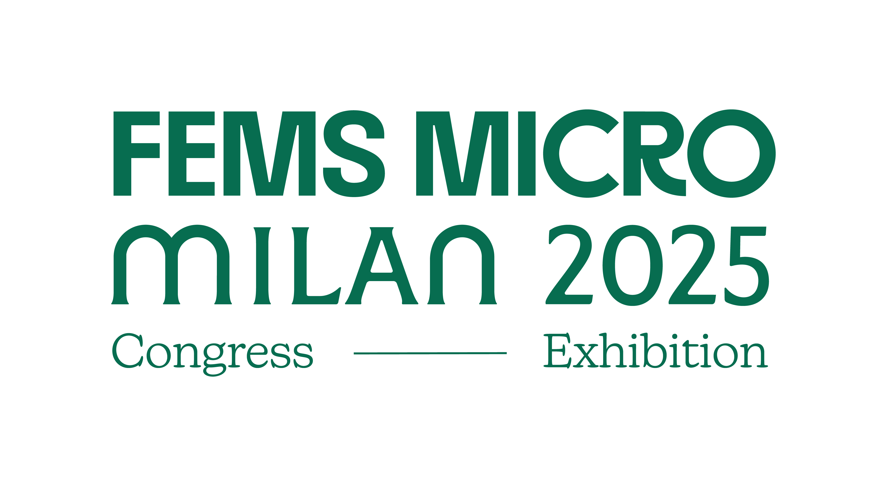

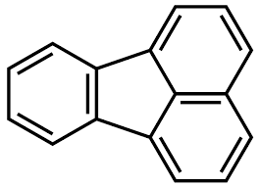
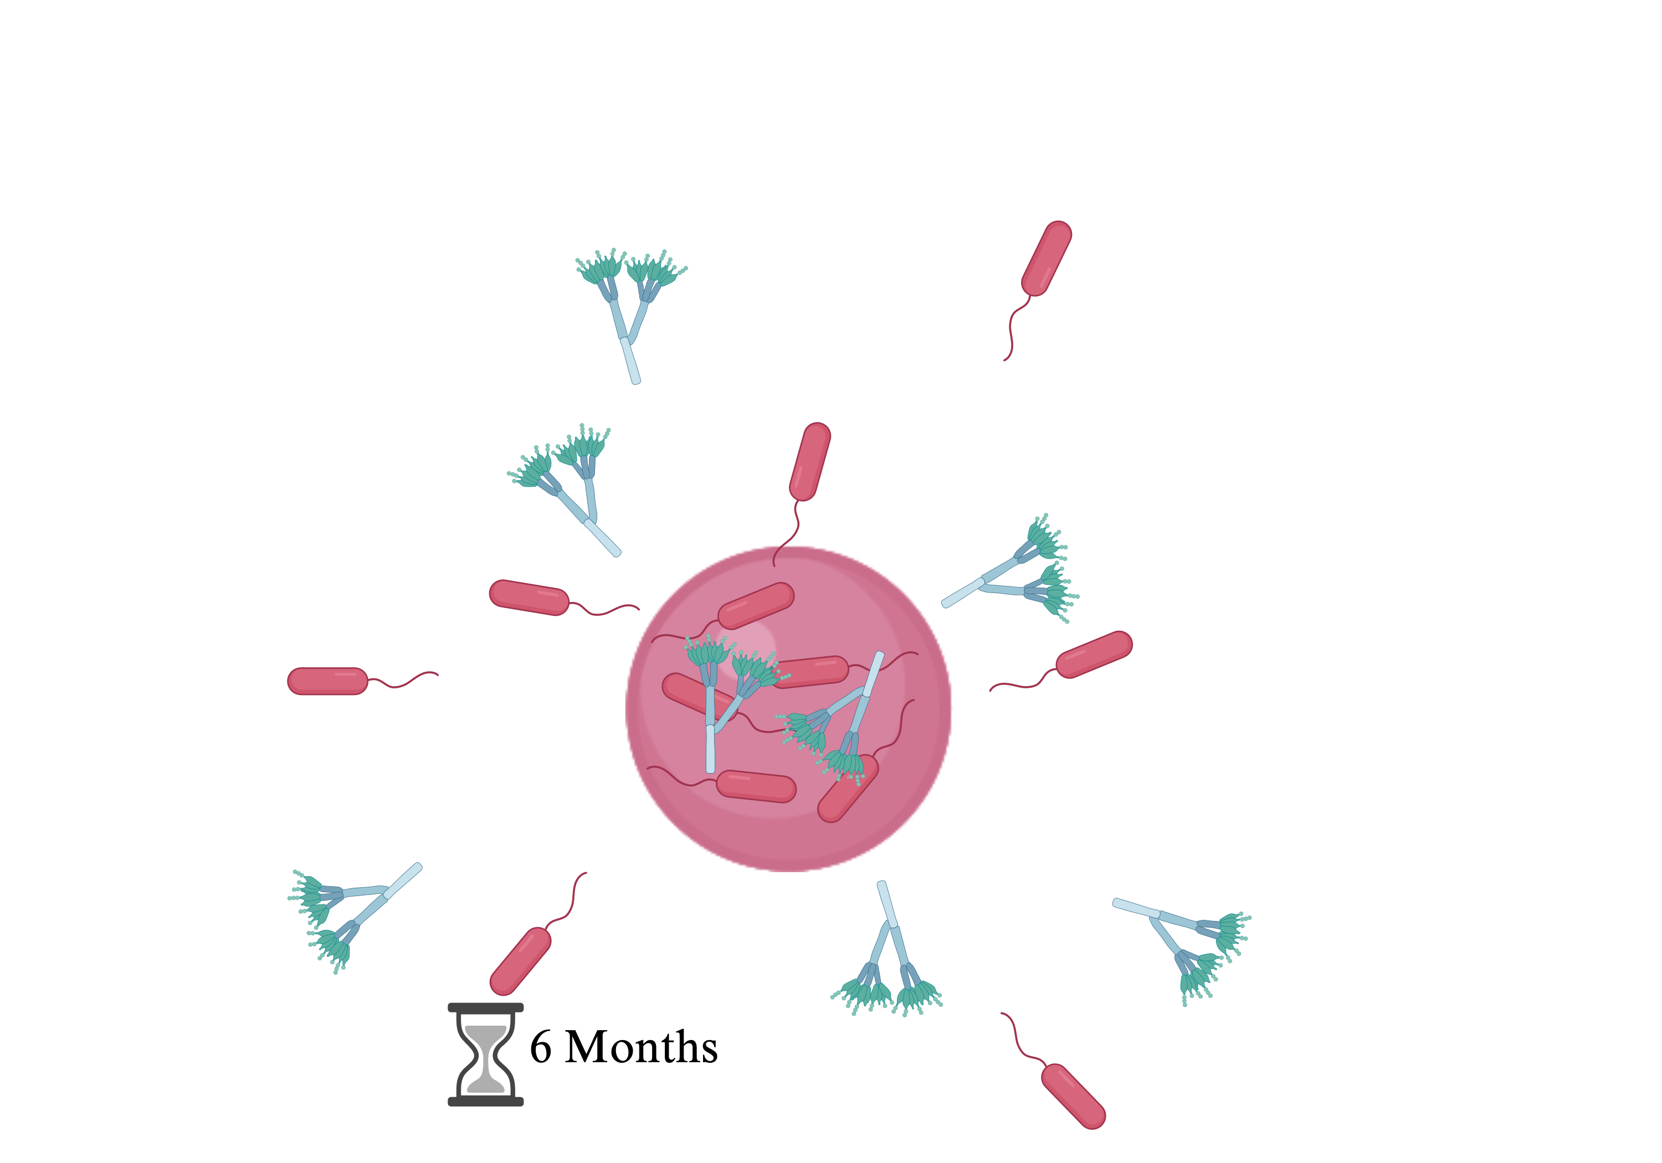
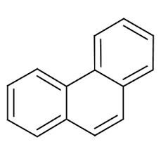
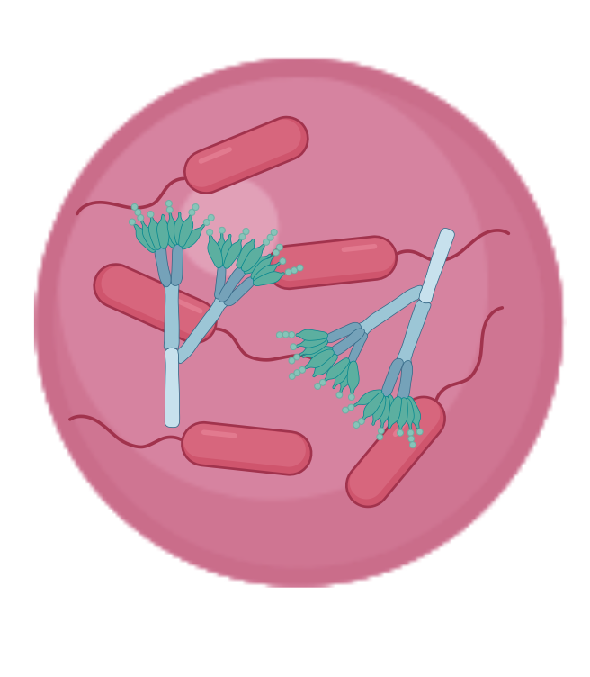
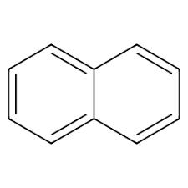
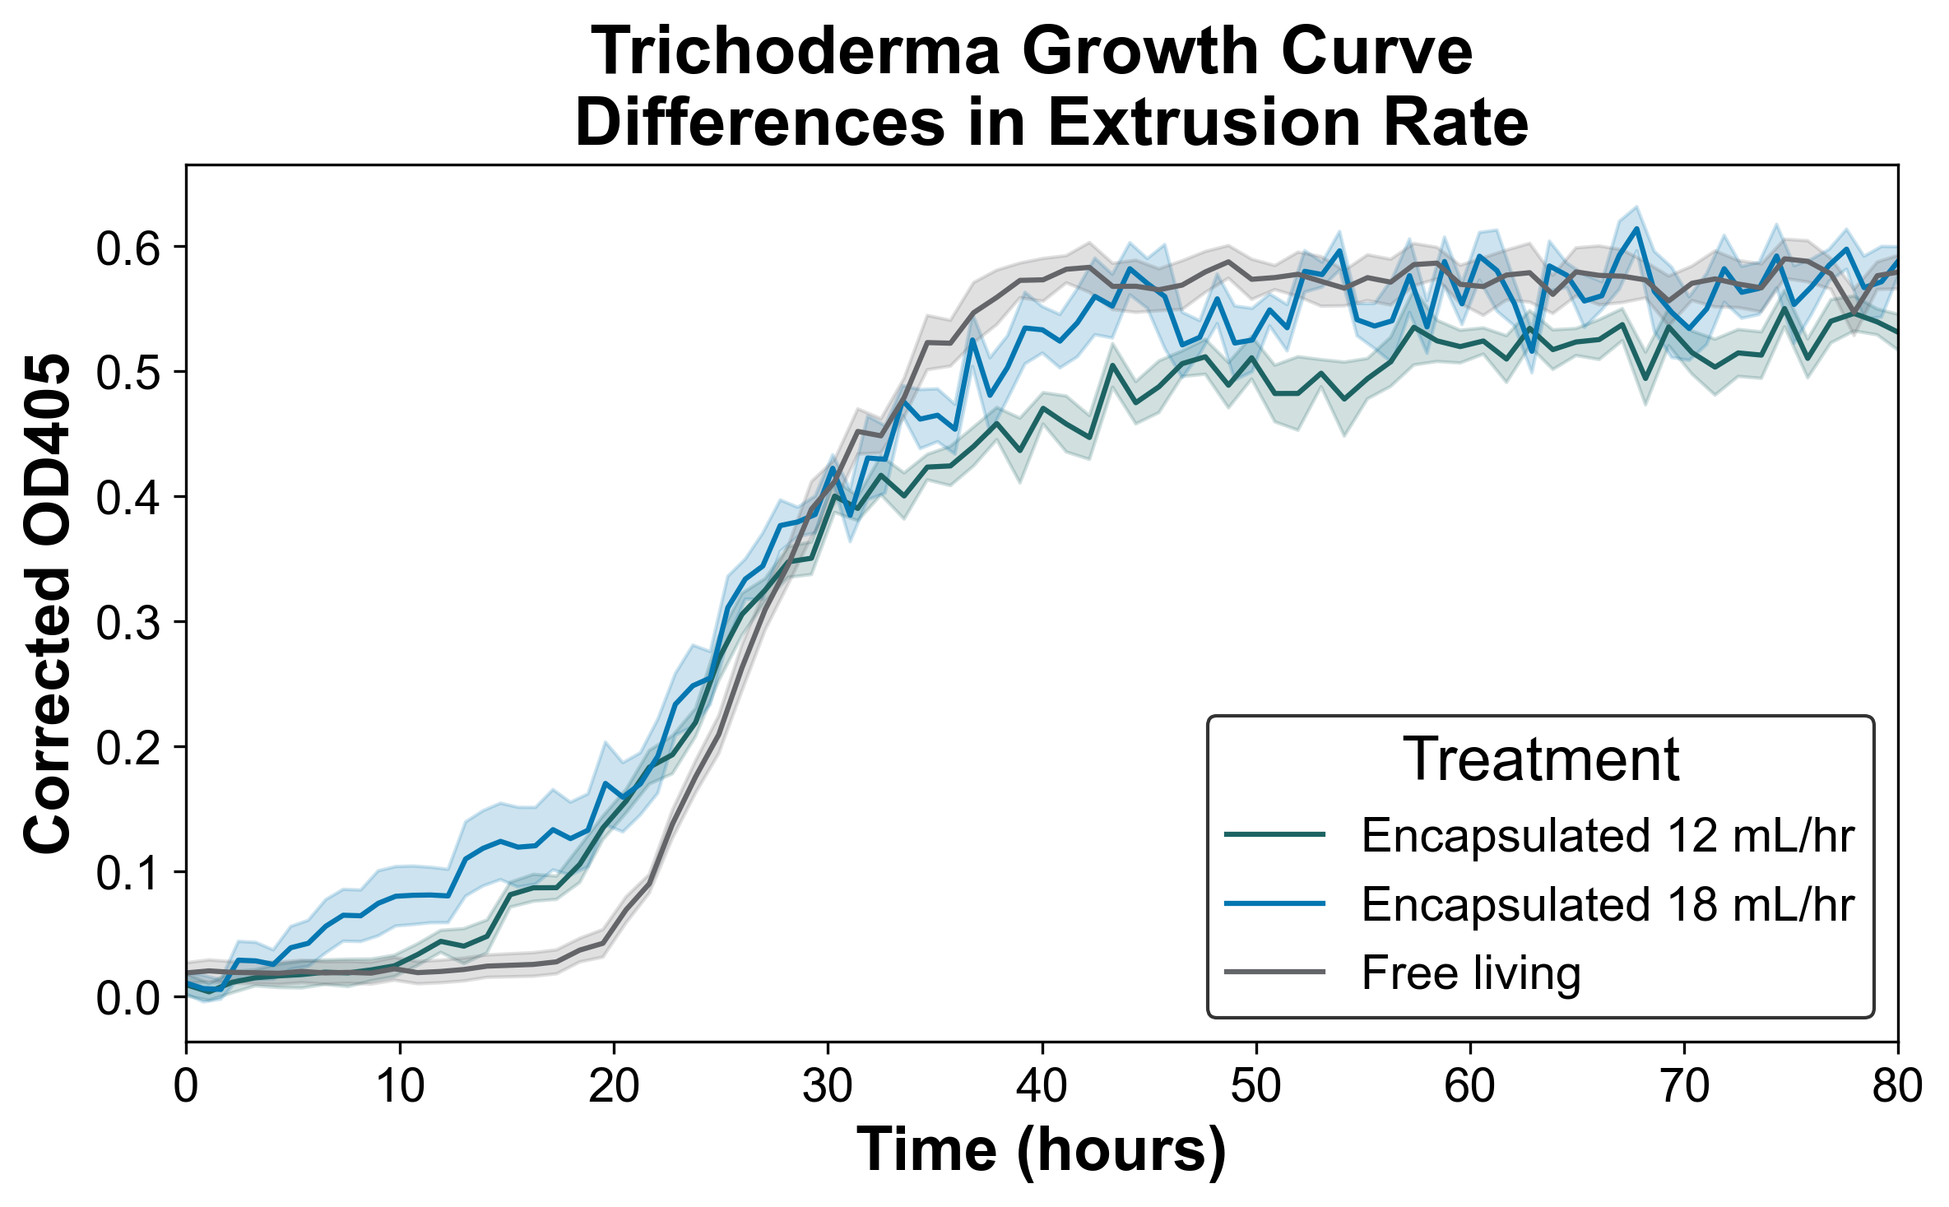
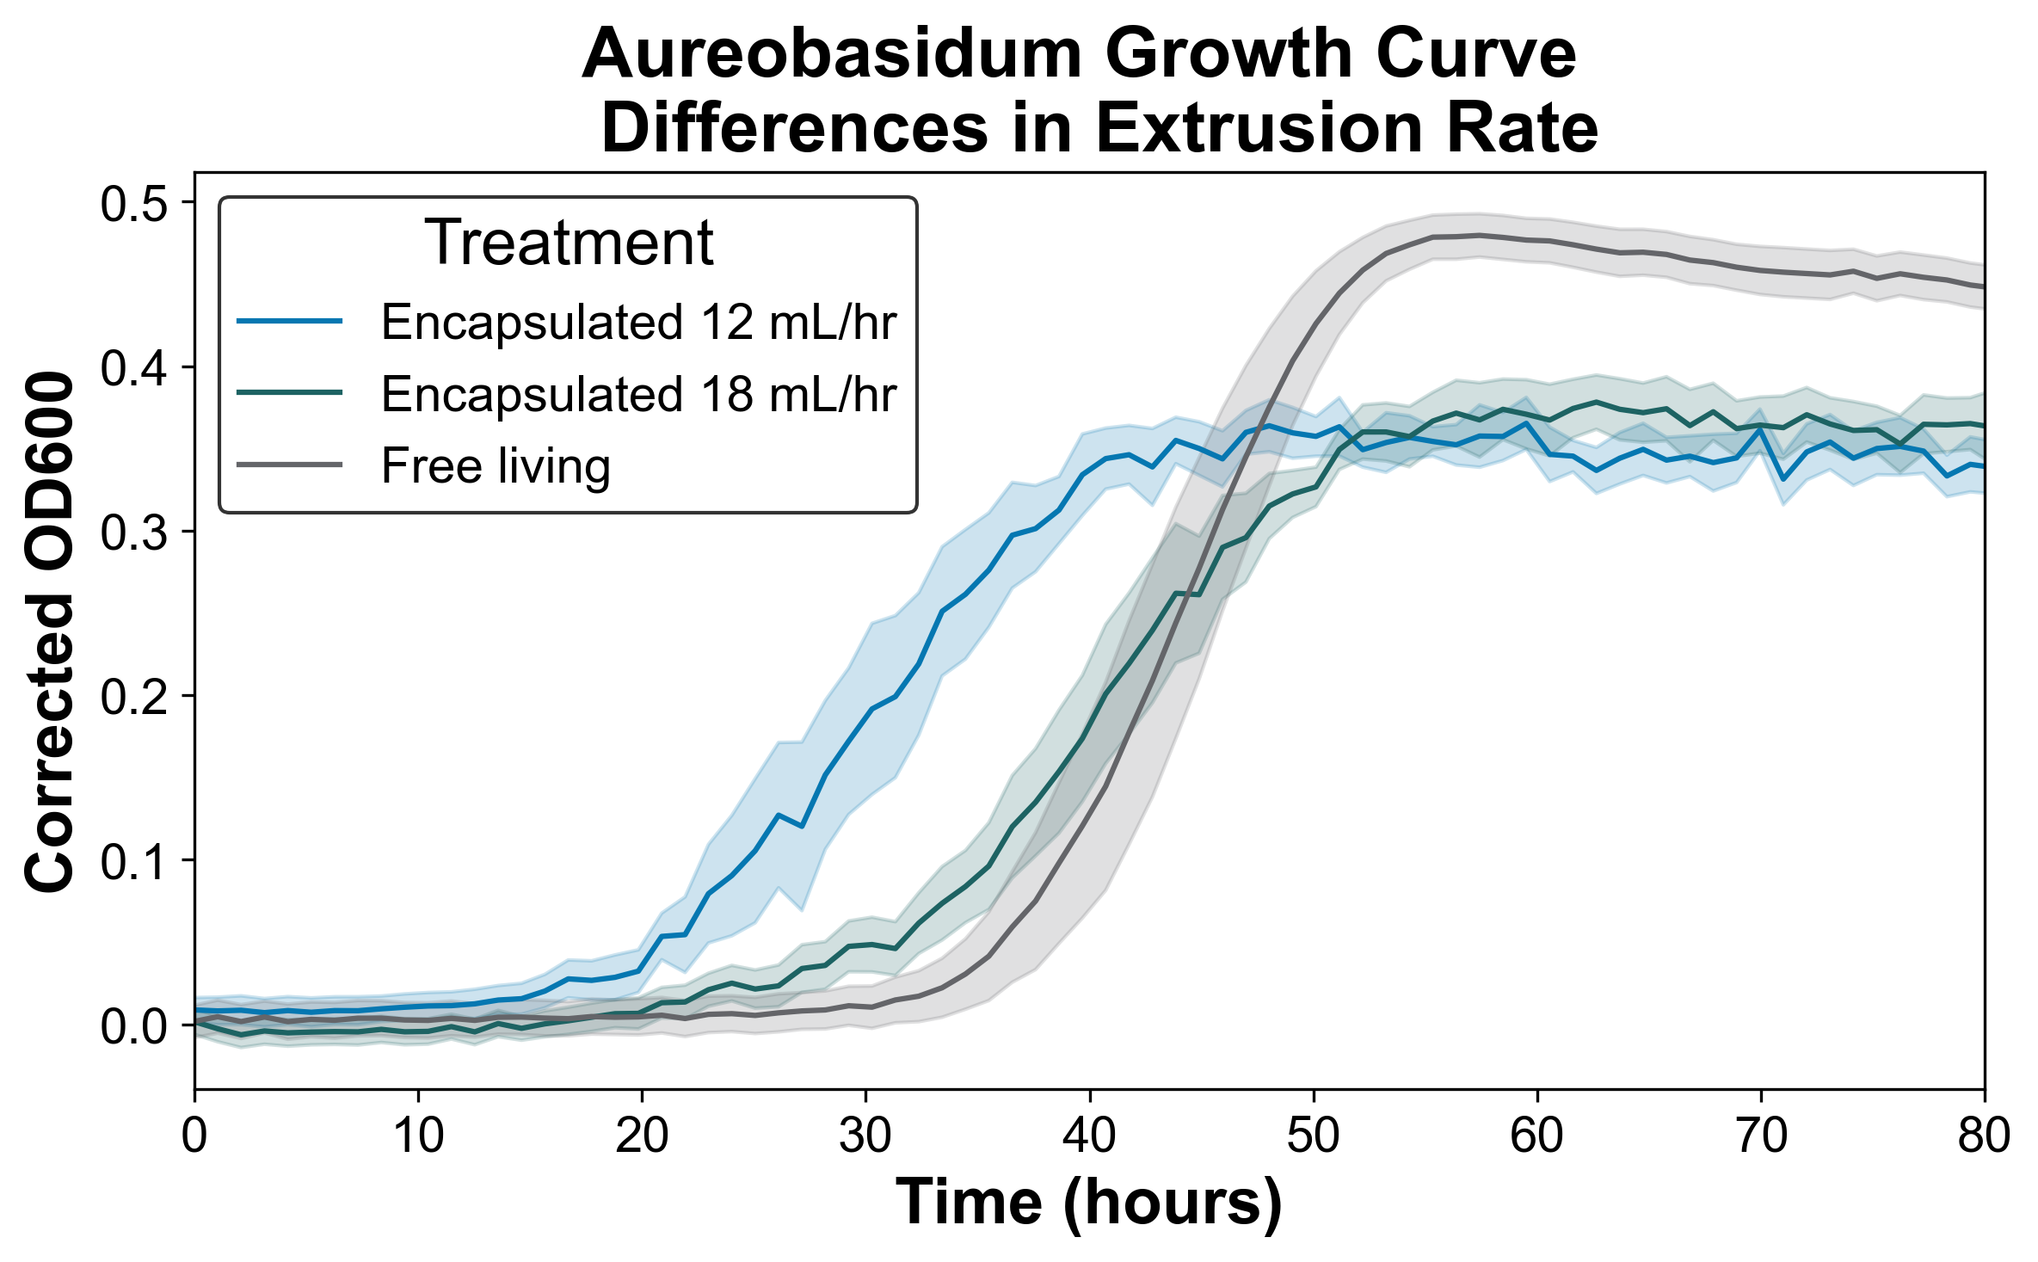
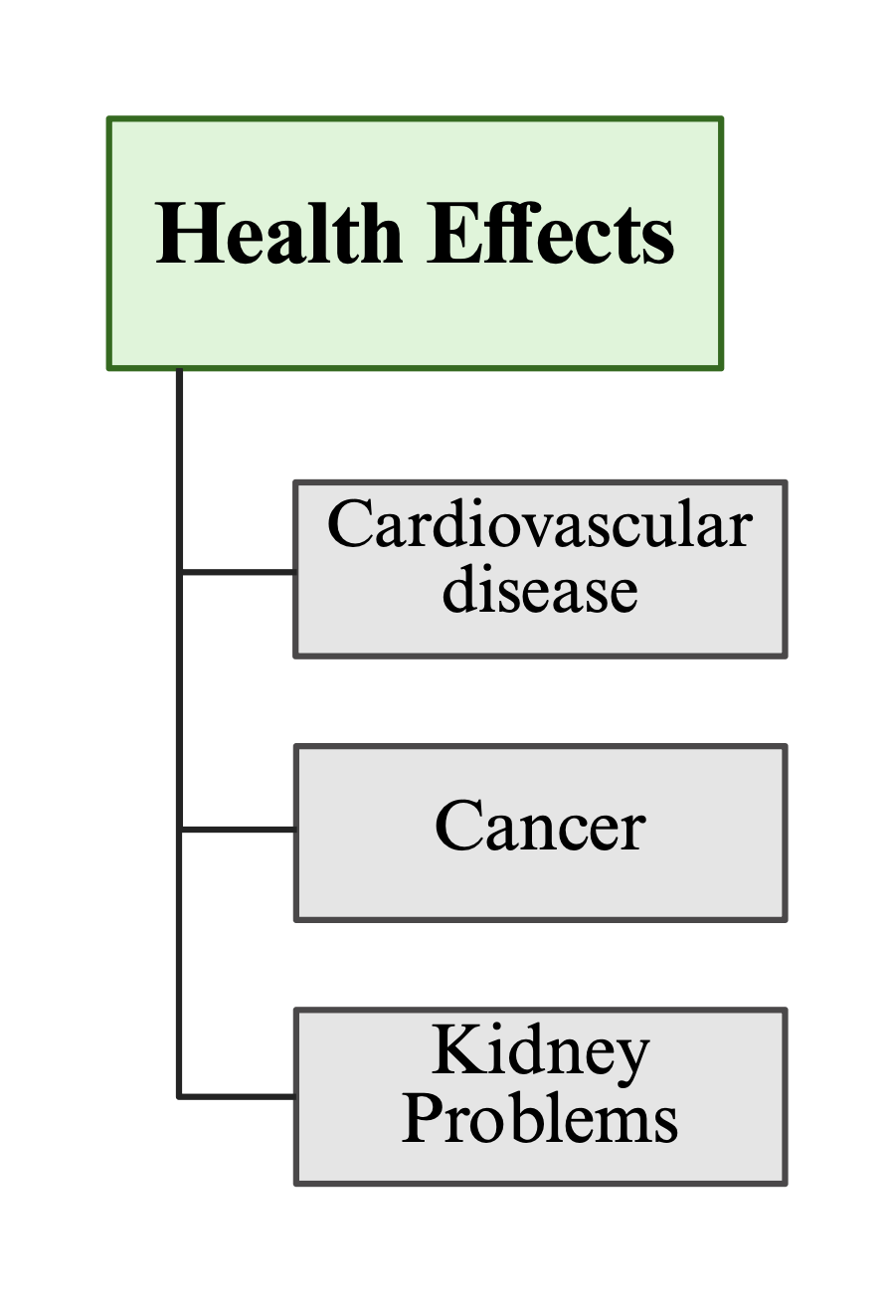
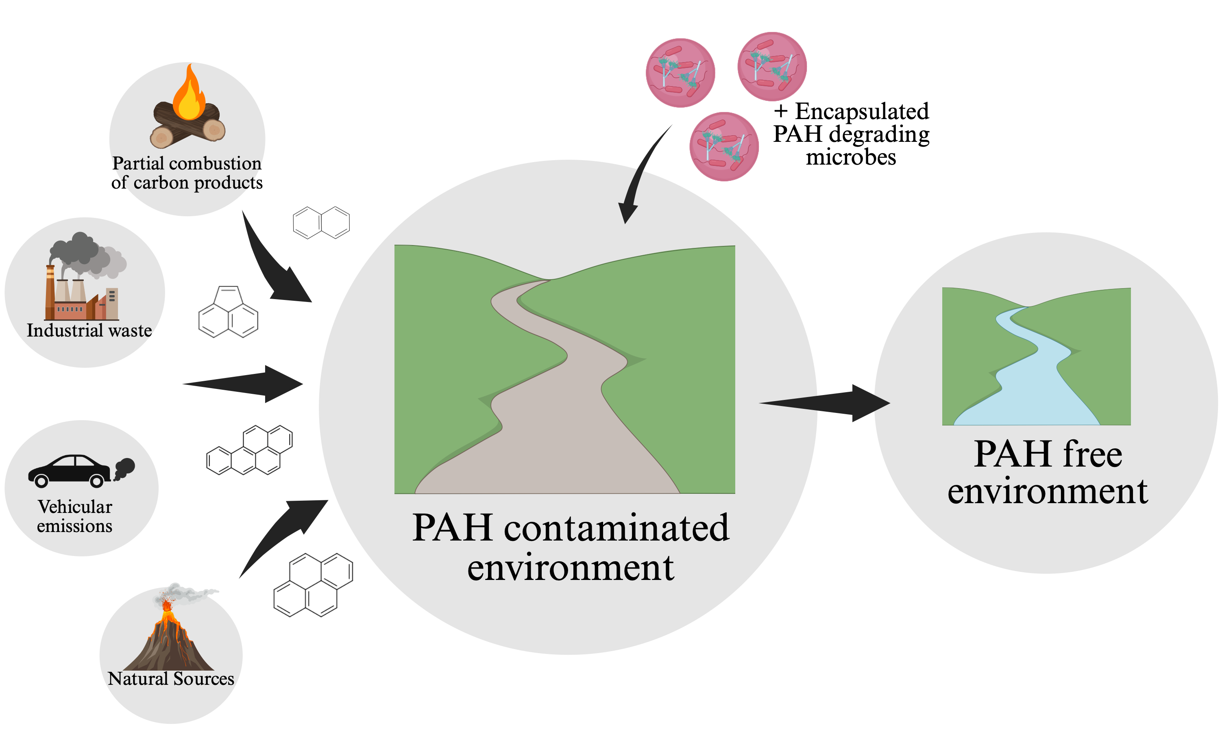
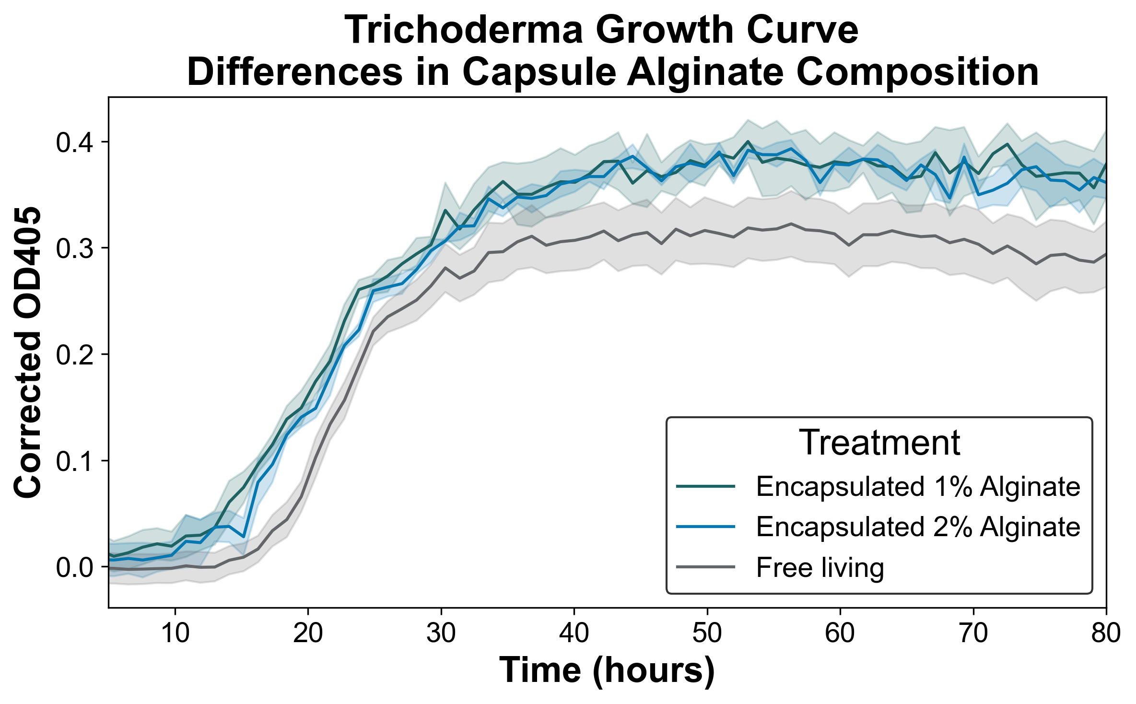
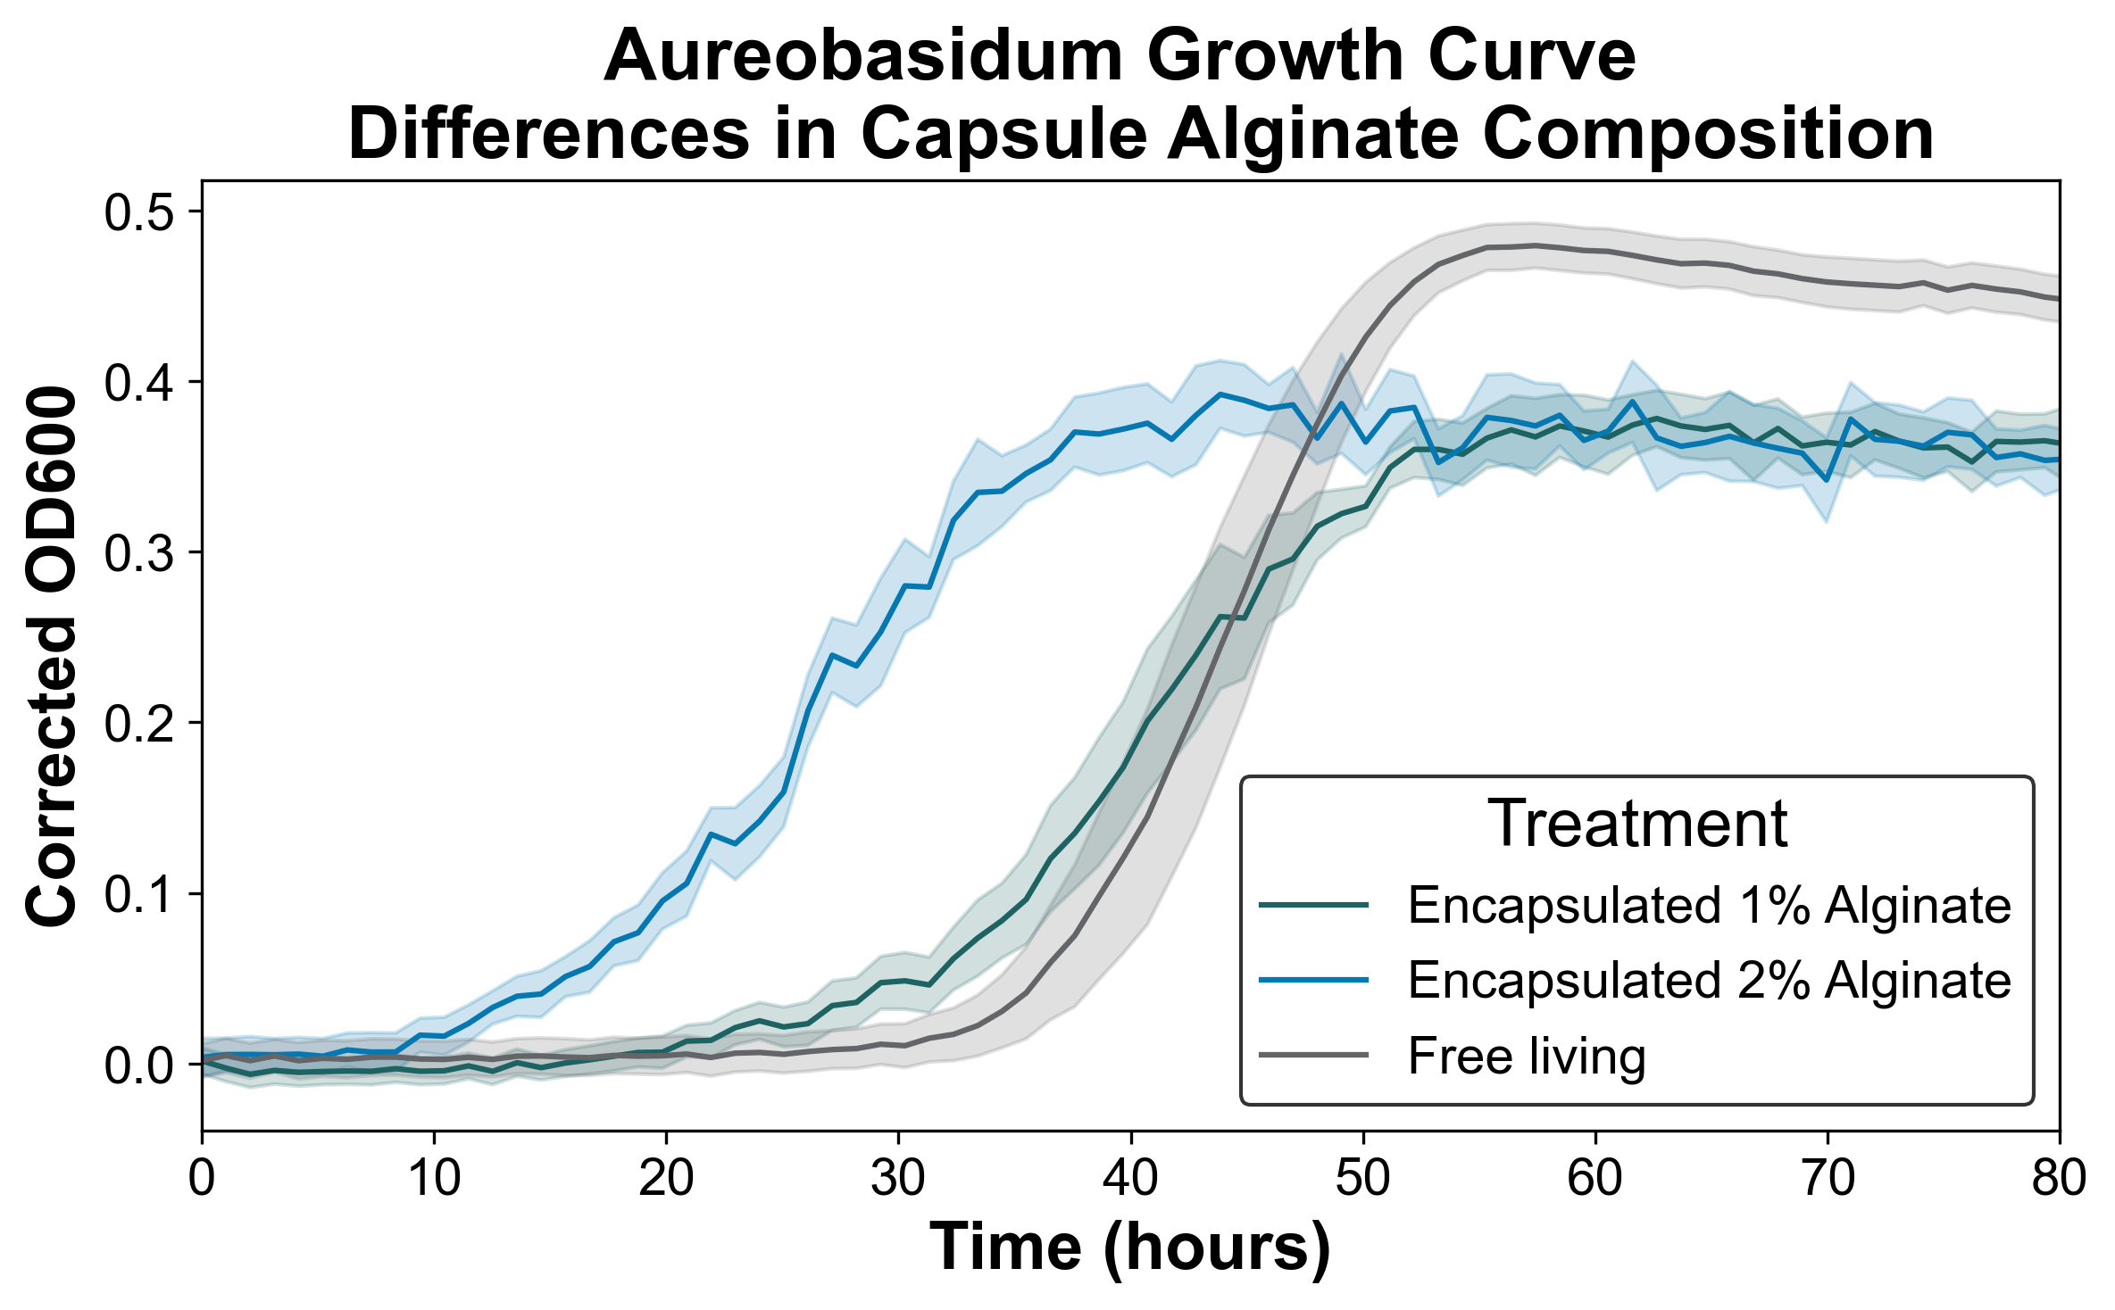
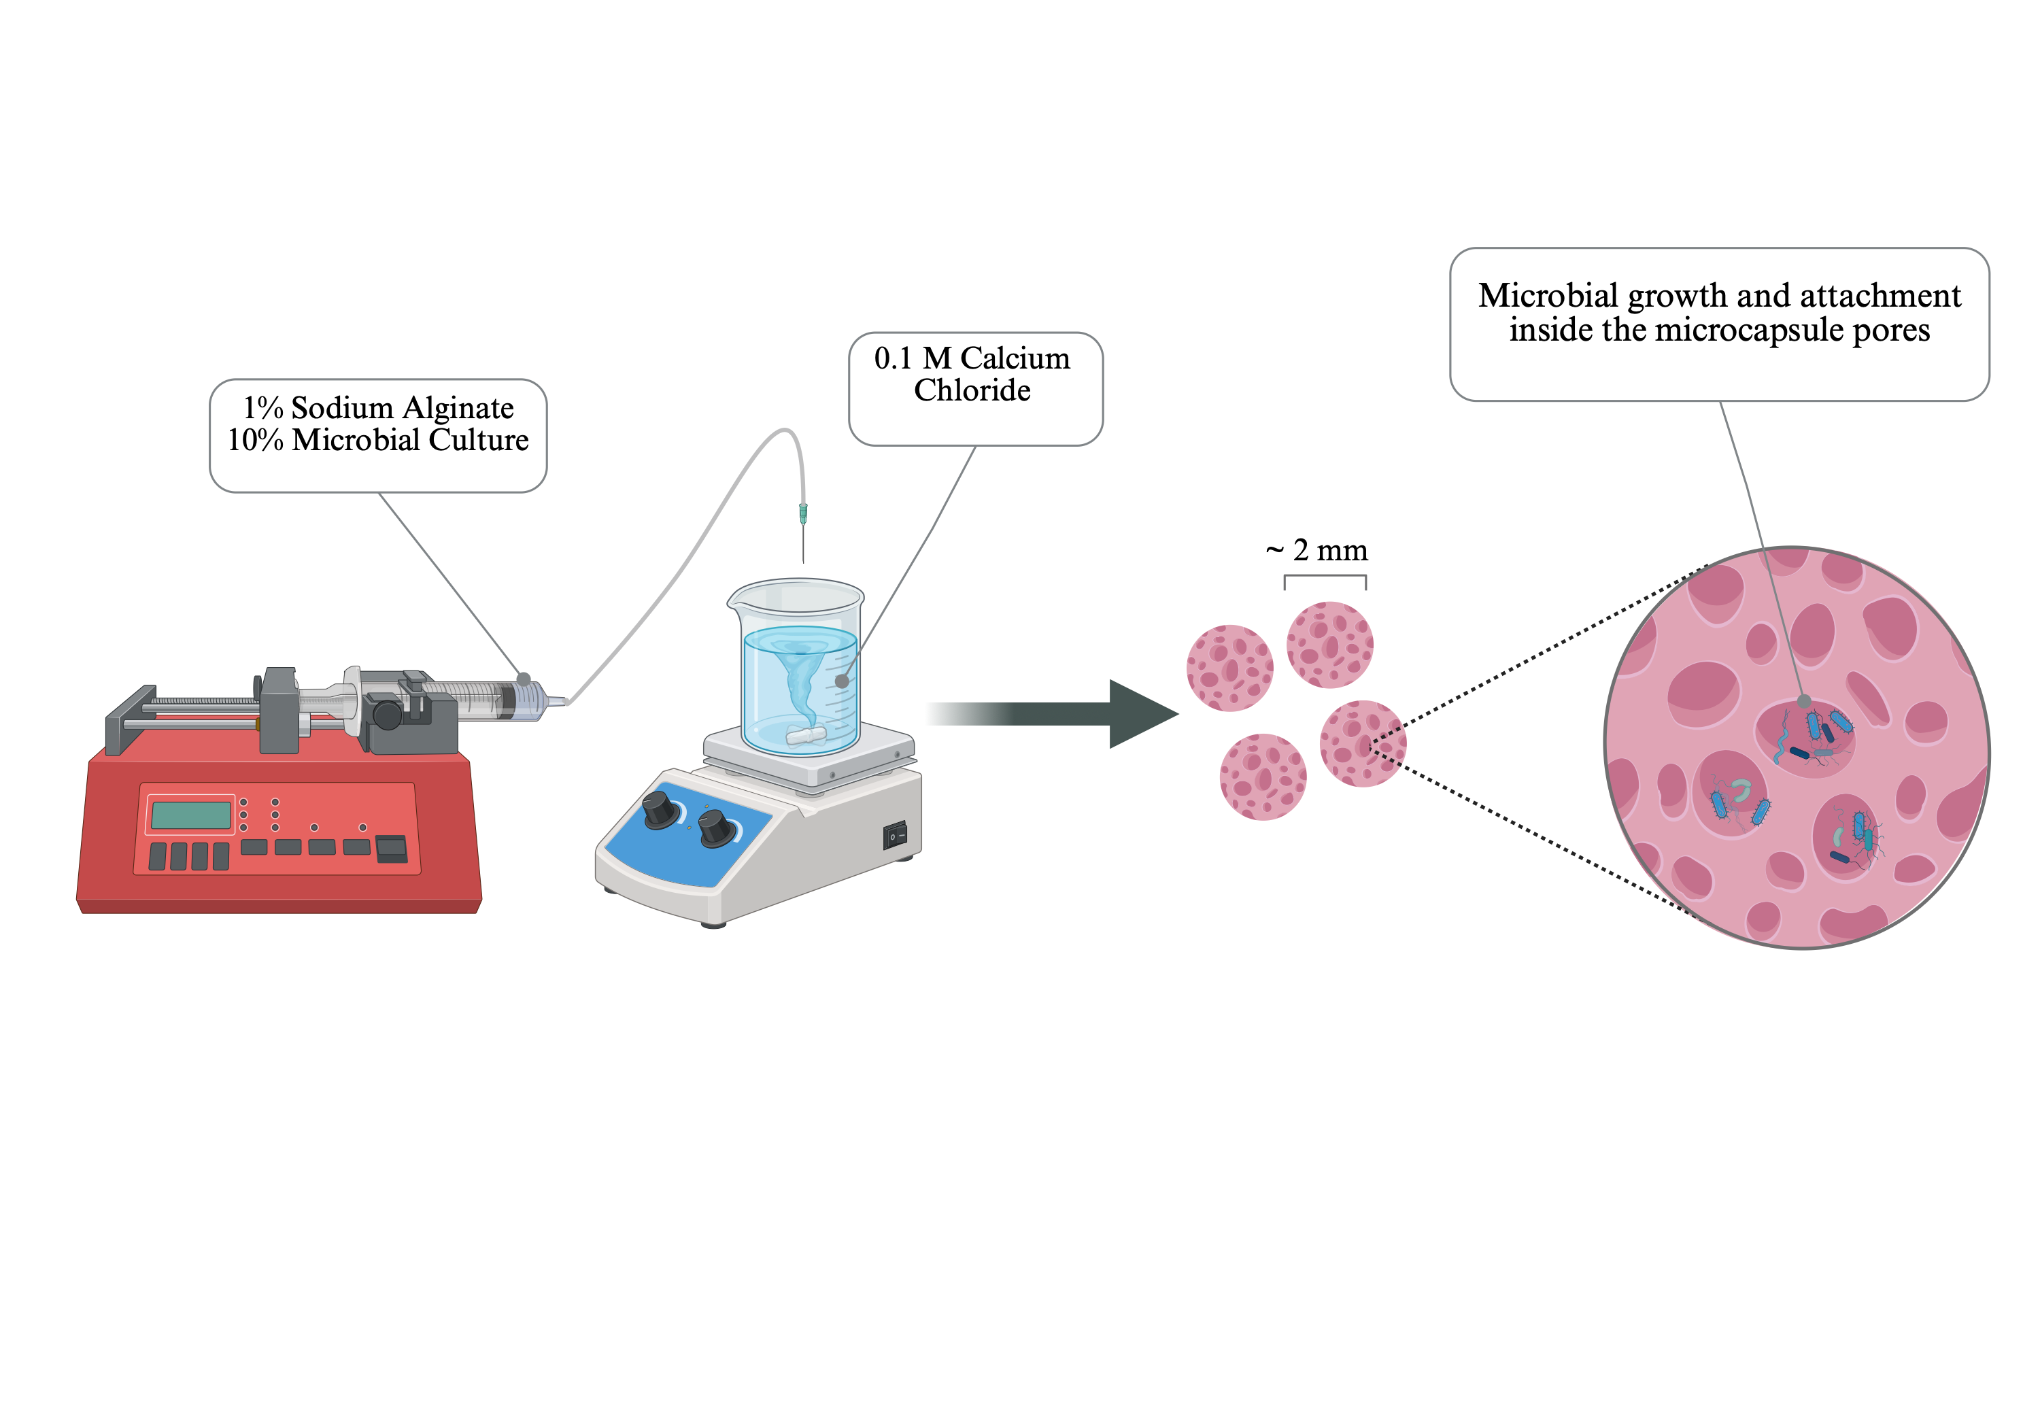
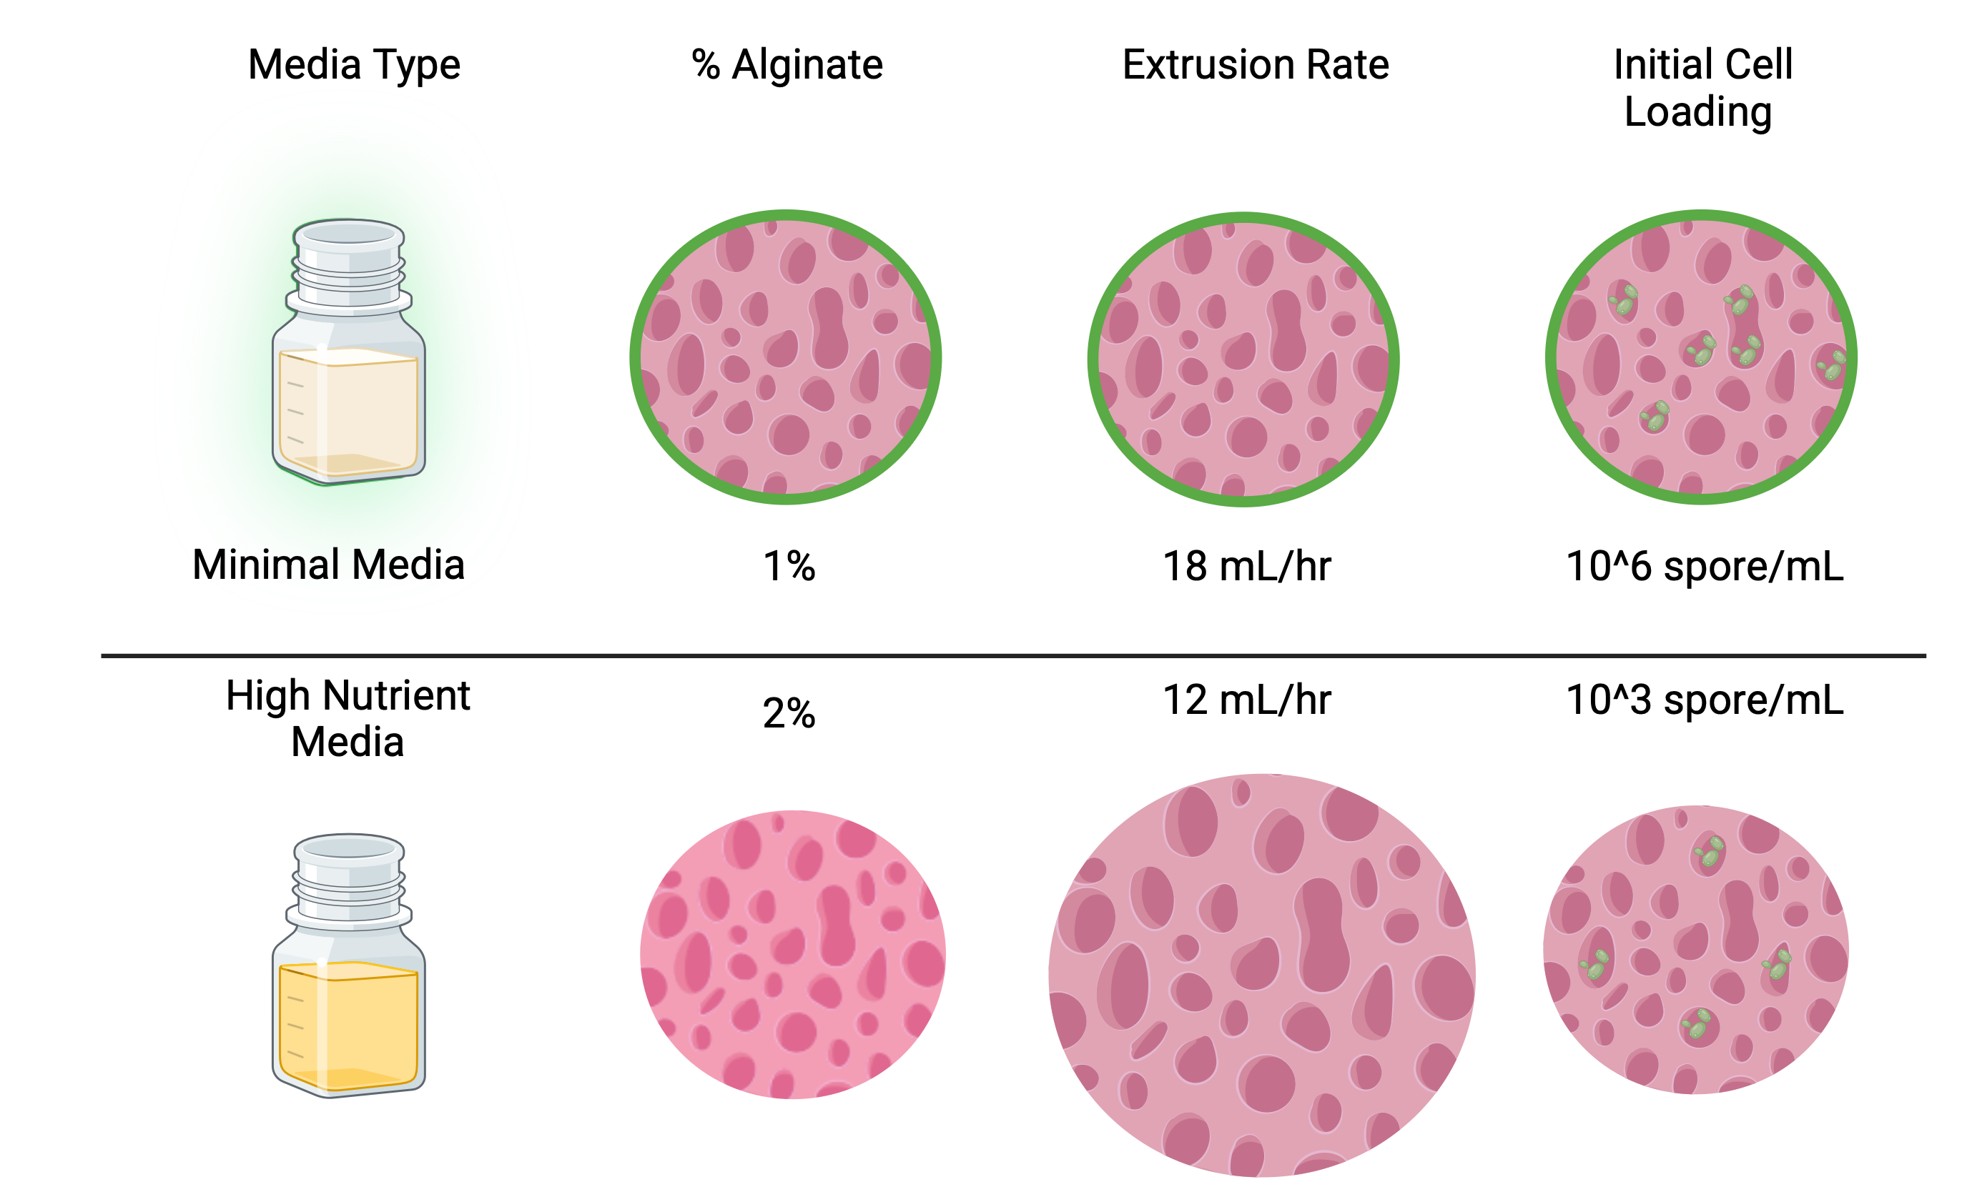
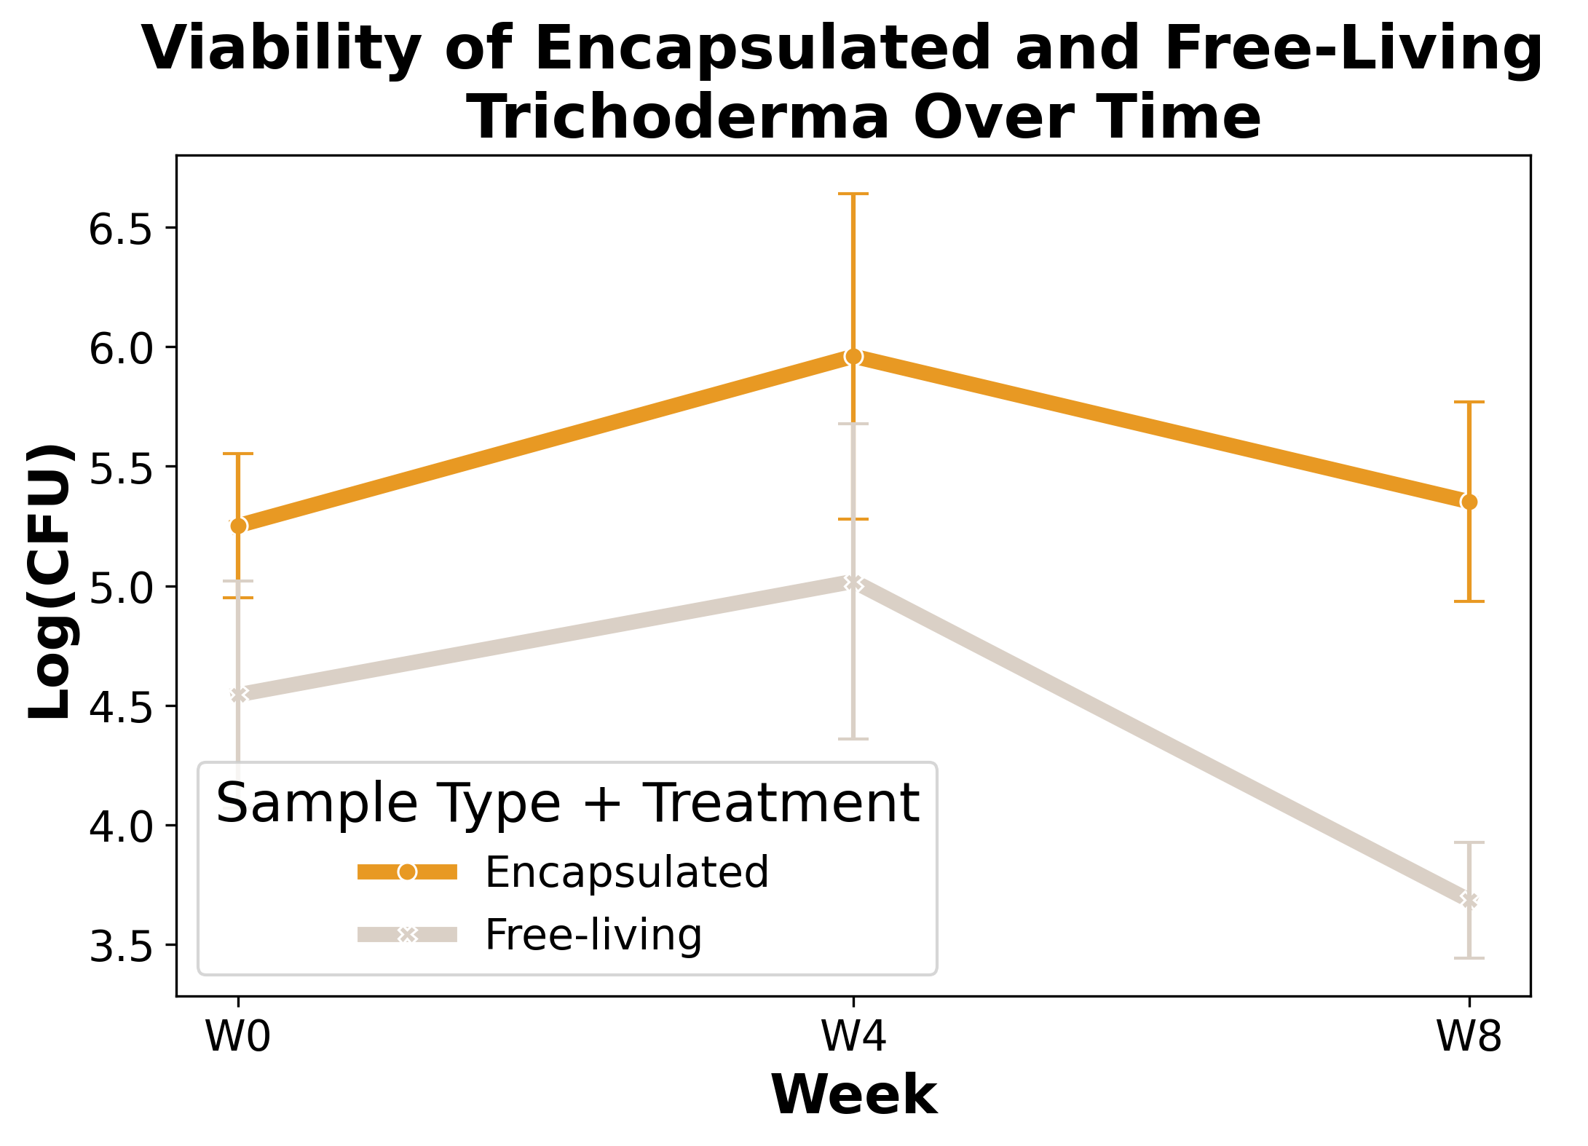
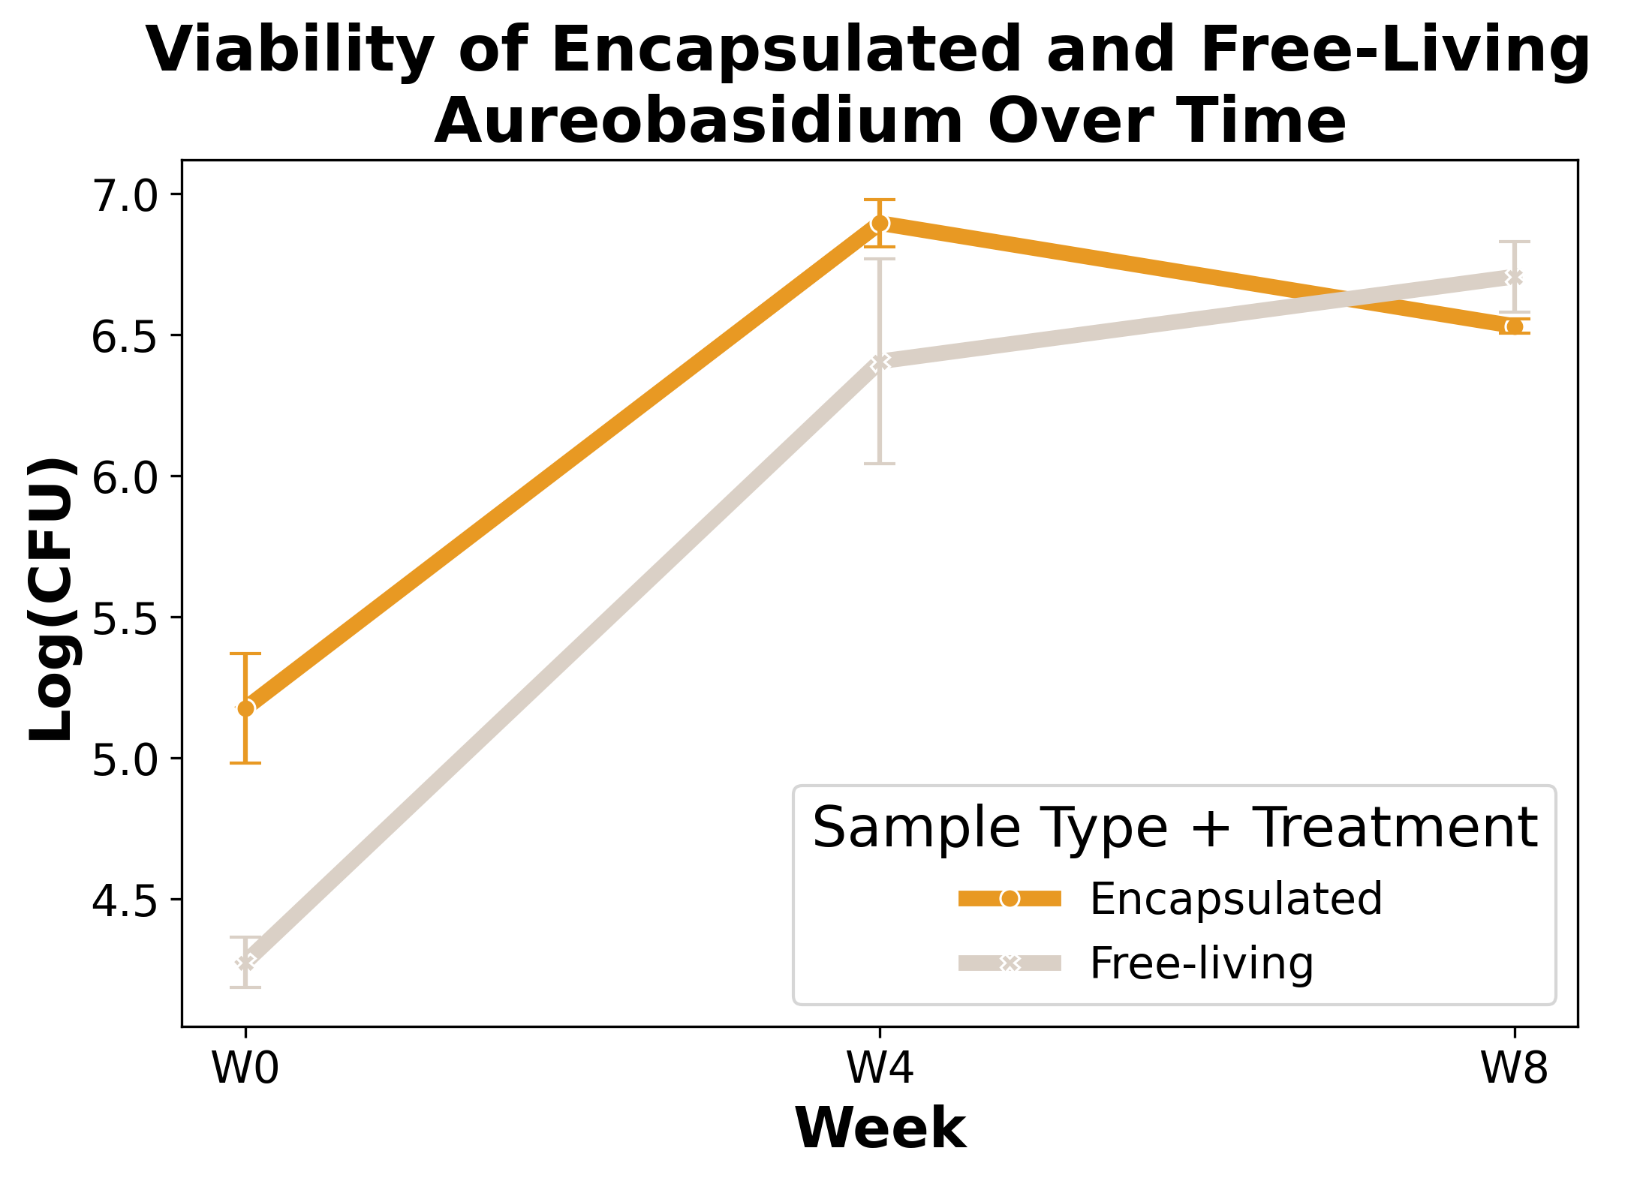
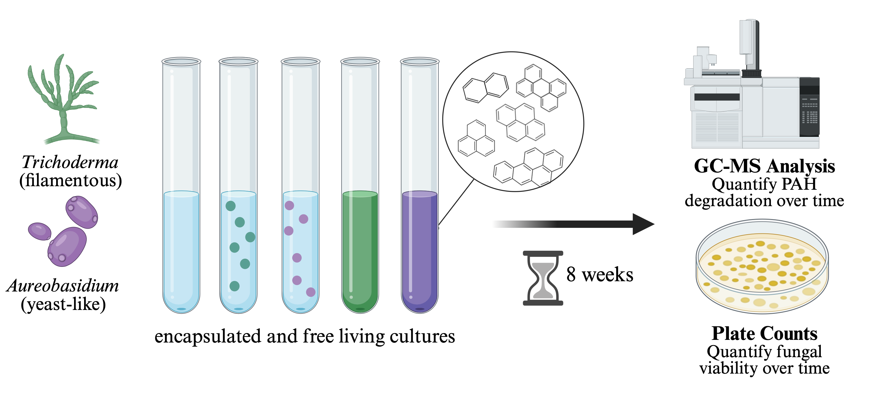





Optimizing Fungal Microencapsulation for Bioremediation of PAHs Erica Babusci and Claudia K Gunsch Department of Civil and Environmental Engineering, Duke University
278.17P
Erica.Babusci@duke.edu
(614)-600-6861
Background
Results
Polycyclic aromatic hydrocarbons (PAHs) are organic pollutants that are a significant public health concern due to their carcinogenic and mutagenic nature^{[1-3].} There are numerous strategies implemented to remediate PAH contamination, many being ecologically intrusive^{[4].} A sustainable and cost-effective alternative is mycoremediation. However, minimal success in PAH degradation has been seen due to planktonic microbes not properly establishing within the novel environment^{[5].}
Growth Curves Comparing Treatments
Trichoderma and Aureobasidium encapsulated cultures showed shorter stationary phase growth than free-living cultures for both extrusion rates but Aureobasidium showed lower overall OD
12 mL/hr promoted an earlier growth rate for both isolates
A
B
Figure 6 (A-B): Figures showing the corrected OD for (A) Trichoderma and (B) Aureobasidium over 80 hours, comparing capsules formed by extrusion rates of 12 mL/hr vs 18 mL/hr to free living cultures
Figure 1: Health effects associated with PAH exposure
Figure 2: The general schematic of the application of capsules for in-situ bioremediation
Trichoderma and Aureobasidium encapsulated cultures showed shorter stationary phase growth than free-living cultures for both extrusion rates but Aureobasidium showed lower overall OD
Alginate concentration does not affect encapsulated Trichoderma growth
2% alginate promoted earlier growth for Aureobasidium
To address this, we are encapsulating PAH-degrading fungi in sodium alginate to enhance their survival and degradation capacity in the environment. We are evaluating the difference between encapsulated and free-living cultures of environmental isolates of Trichoderma and Aureobasidium⁶ to measure growth, viability, and PAH degradation^{7.}
A
B
Methods
Capsule Formation
Figure 6 (A-B): Figures showing the corrected OD for (A) Trichoderma and (B) Aureobasidium over 80 hours, comparing capsules formed by 1% and 2% alginate to free living cultures
Figure 3: Syringe pump set up for forming capsules via extrusion⁸
Long Term Viability
Different Capsules Being Tested
Encapsulation promoted viability of Trichoderma cultures after 8 weeks but had no effect on Aureobasidium
Baseline capsule formula
A
B
Figure 4: Different conditions in which capsules will be formed and compared to the baseline.
Figure 8 (A-B): Figures showing the total concentration of (A) Trichoderma and (B) Aureobasidium after 0,4, and 8 weeks. Capsuled formed with the baseline capsule formation
Long Term Viability and PAH Degradation
References and Acknowledgments
[1] US EPA (2023), Superfund [2] Di Giulio, R. T., & Clark, B. W. (2015). J Tox and Env Health [3] Baek, et al. (1991) Water Air Soil Pollut. [4] Seo, J.-S., Keum, Y.-S., & Li, Q. X. (2009). Bacterial Degradation of Aromatic Compounds. [5] Omokhagbor Adams et al., (2020) International Journal of Environmental Bioremediation & Biodegradation [6] Valdivia-Rivera, et al. (2021). Reviews in Environmental Science and Bio/Technology. [7] Volkoff, et al. (2019) Duke University. [8] Yueng, et al. (2016) Front. Microbial. [9] Meletiadis, et al. (2001) ASM Journals​
This material is based upon work supported by the National Institute of Environmental Health Sciences Under Grant Number P42ES010356
FEMS MICRO Milan 2025: Congress & Exhibition
Figure 5: Cultures will have model PAHs injected in the cultures and let grow for 8 weeks, with data collected at 0,4, and 8 weeks⁹.

